Slide 1
Probability and Statistics
ML Study Group

Slide 2
Statistics has three primary components
1. Identify a question or problem.
2. Collect relevant data on the topic.
3. Analyze the data.
4. Form a conclusion.

Slide 3
Statistics
Descriptive Statistics
Inferential Statistics

Slide 4
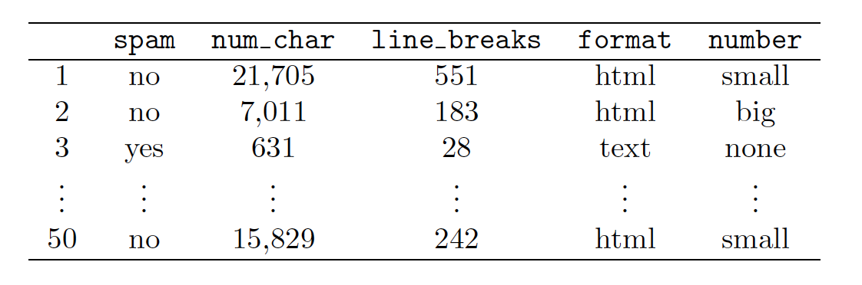
Observations, variables, and data matrices

Slide 5
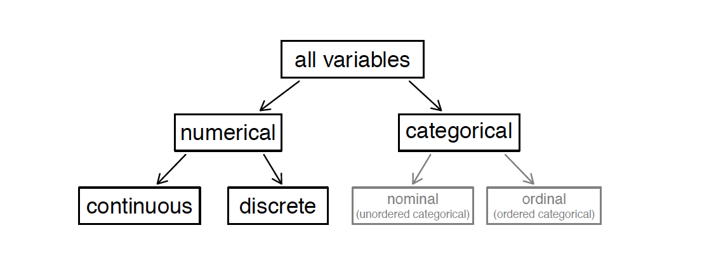
Types of Variables

Slide 6
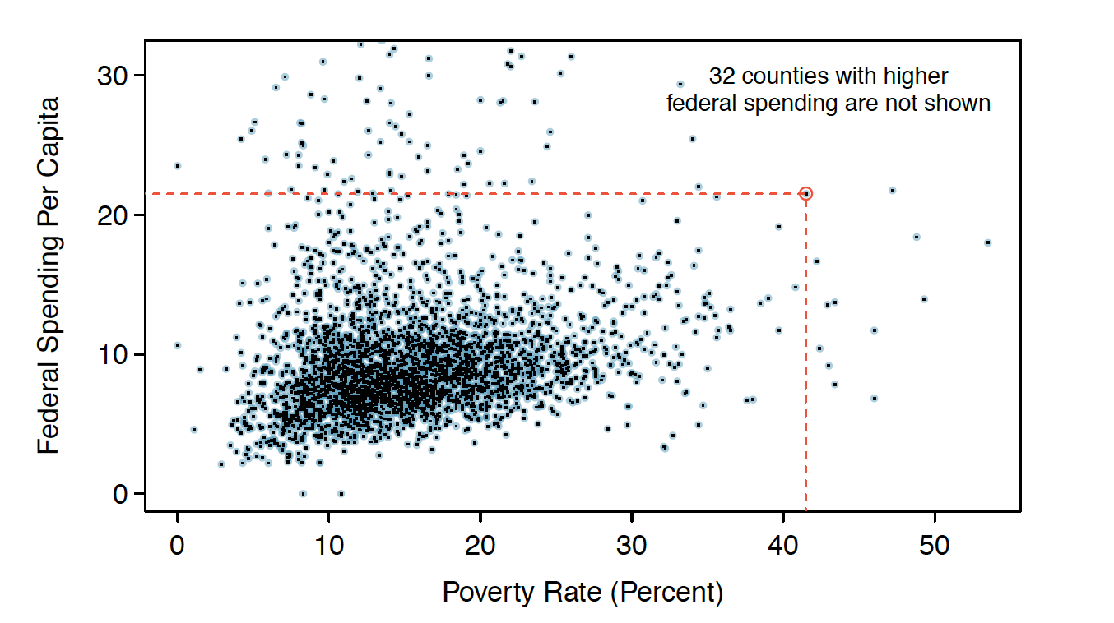
scatterplot to find relation between two variables
negatively associated.
positive association
independent.

Slide 7

Explanatory and response variables
association does not imply causation

Slide 8
observational studies and experiments
data in observational studies are collected only by monitoring what occurs, while experiments require the primary explanatory variable in a study be assigned for each subject by the researchers.

Slide 9
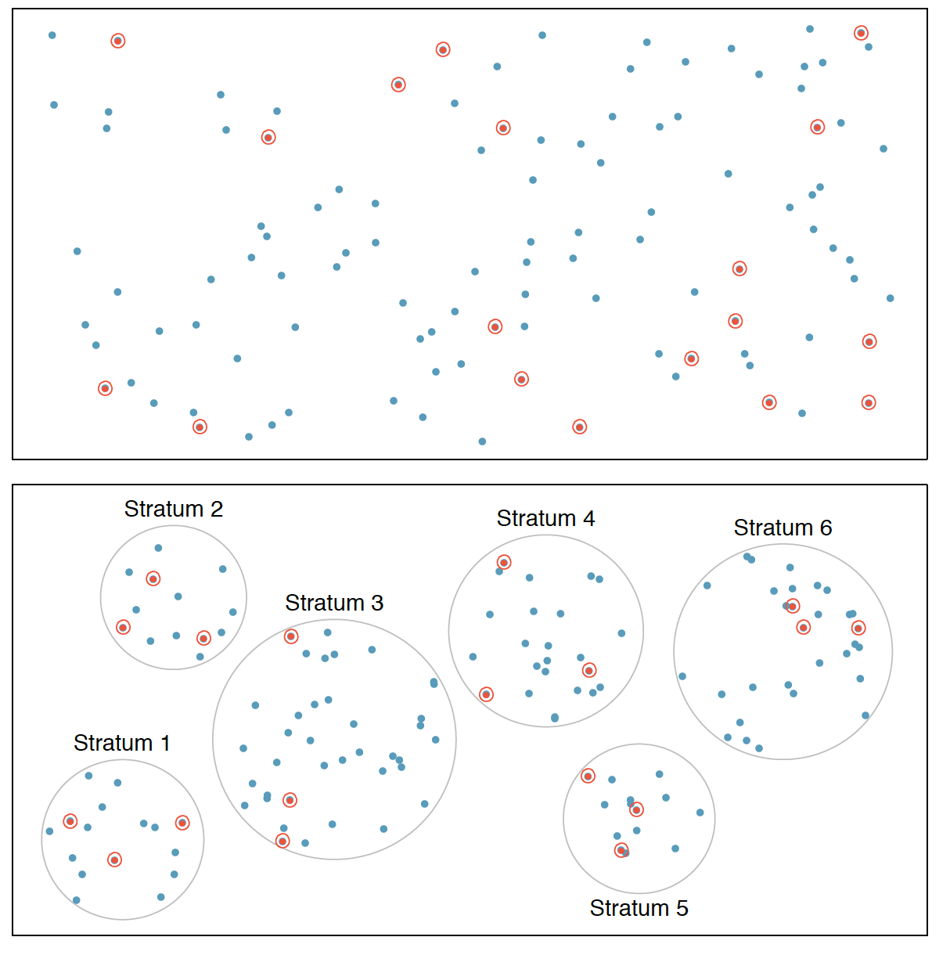
Sampling Methods
Figure 1.14: Examples of simple random and stratified sampling. In the top
panel, simple random sampling was used to randomly select the 18 cases.
In the bottom panel, stratified sampling was used: cases were grouped into
strata, then simple random sampling was employed within each stratum

Slide 10
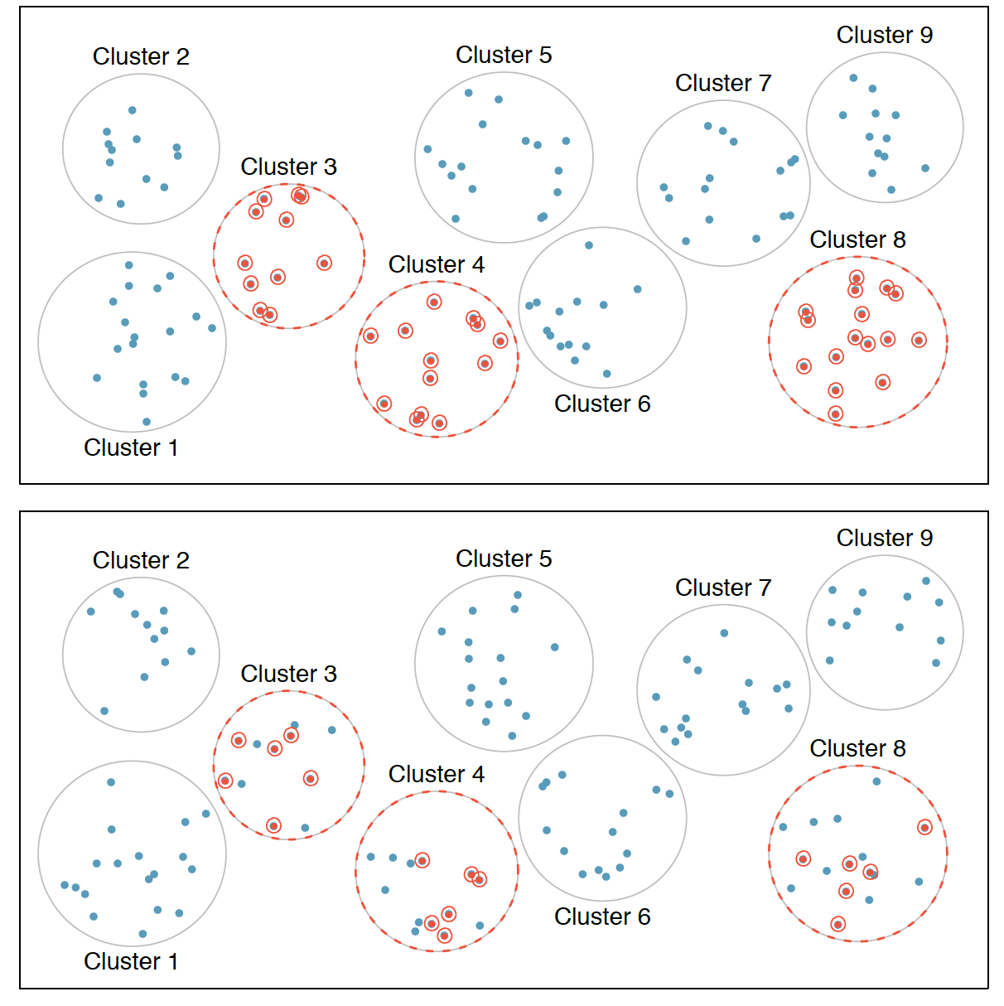

Slide 11
Examining numerical data
Scatterplots for paired data
Dot plots and the mean
Histograms and shape
Variance and standard deviation
Box plots, quartiles, and the median
Pp plots and qq plots

Slide 12
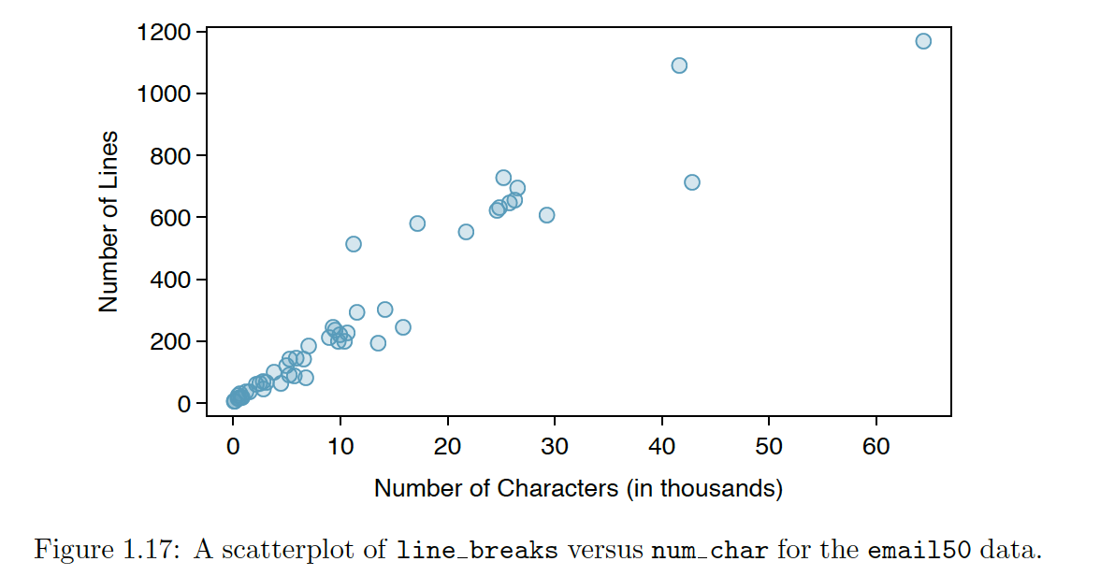
Scatterplots for paired data

Slide 13
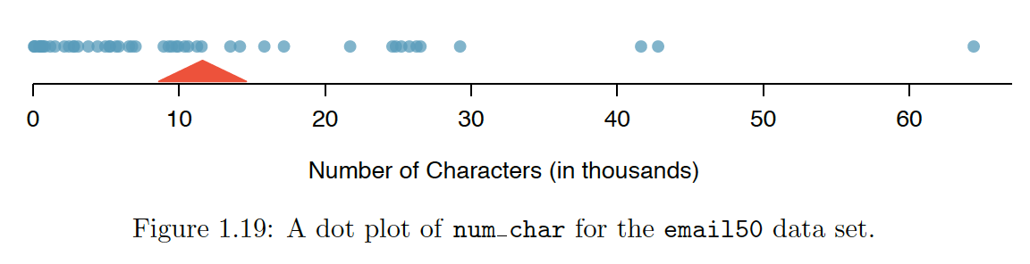
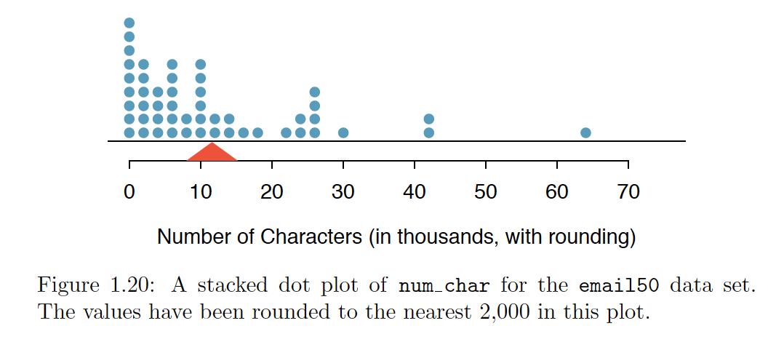
Dot plots and the mean

Slide 14
Histogram
data density.
right skewed
left skewed
symmetric

Slide 15
Histogram Modality

Slide 16
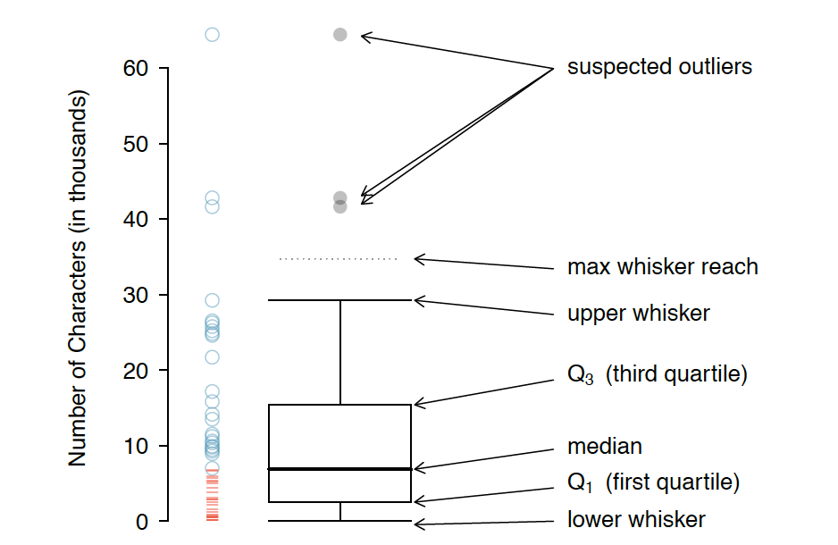
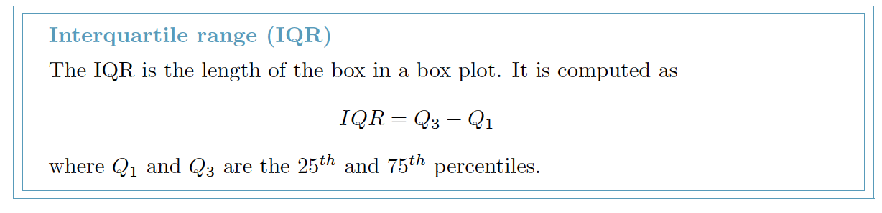
Box plots, quartiles, and the median

Slide 17
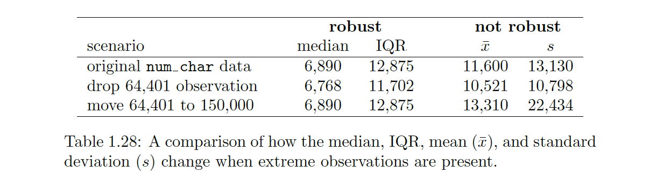
robust estimates
The median and IQR
extreme observations have little effect on their values.
The mean and standard deviation are much more affected by changes in extreme observations.

Slide 18
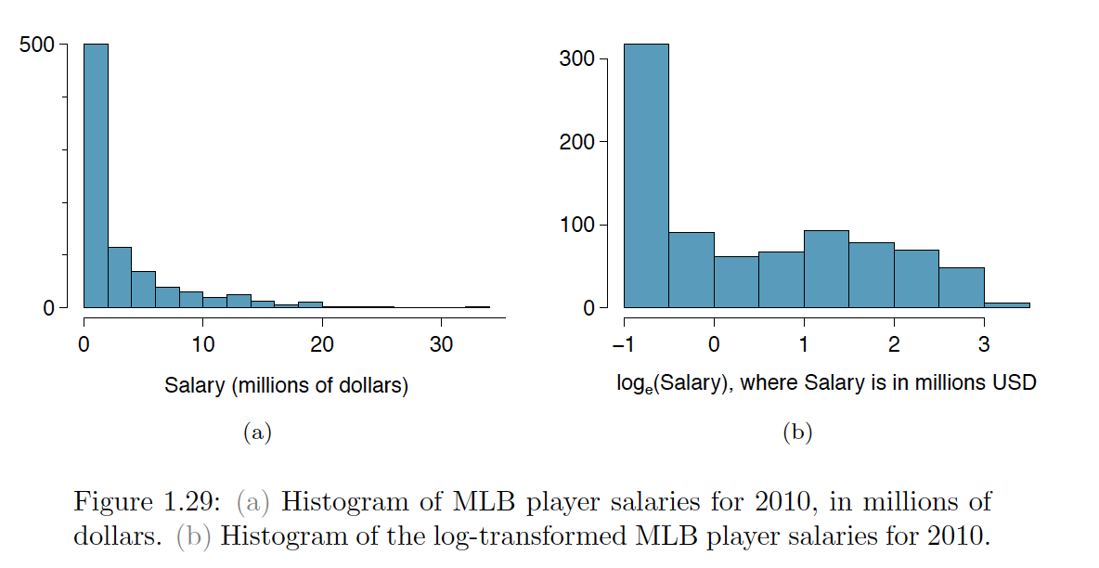
Transforming data
When data are very strongly skewed, we sometimes transform them so they are easier to model
A transformation is a rescaling of the data using a function

Slide 19
Examining categorical data
Contingency tables and bar plots
Row and column proportions
Segmented bar and mosaic plots

Slide 20
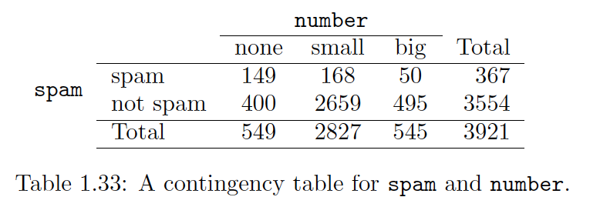
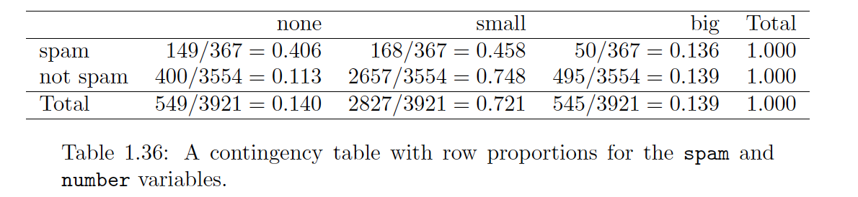
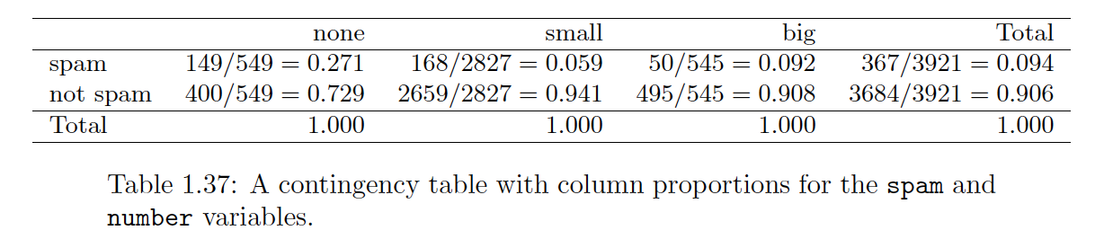
Contingency tables, Row and column

Slide 21
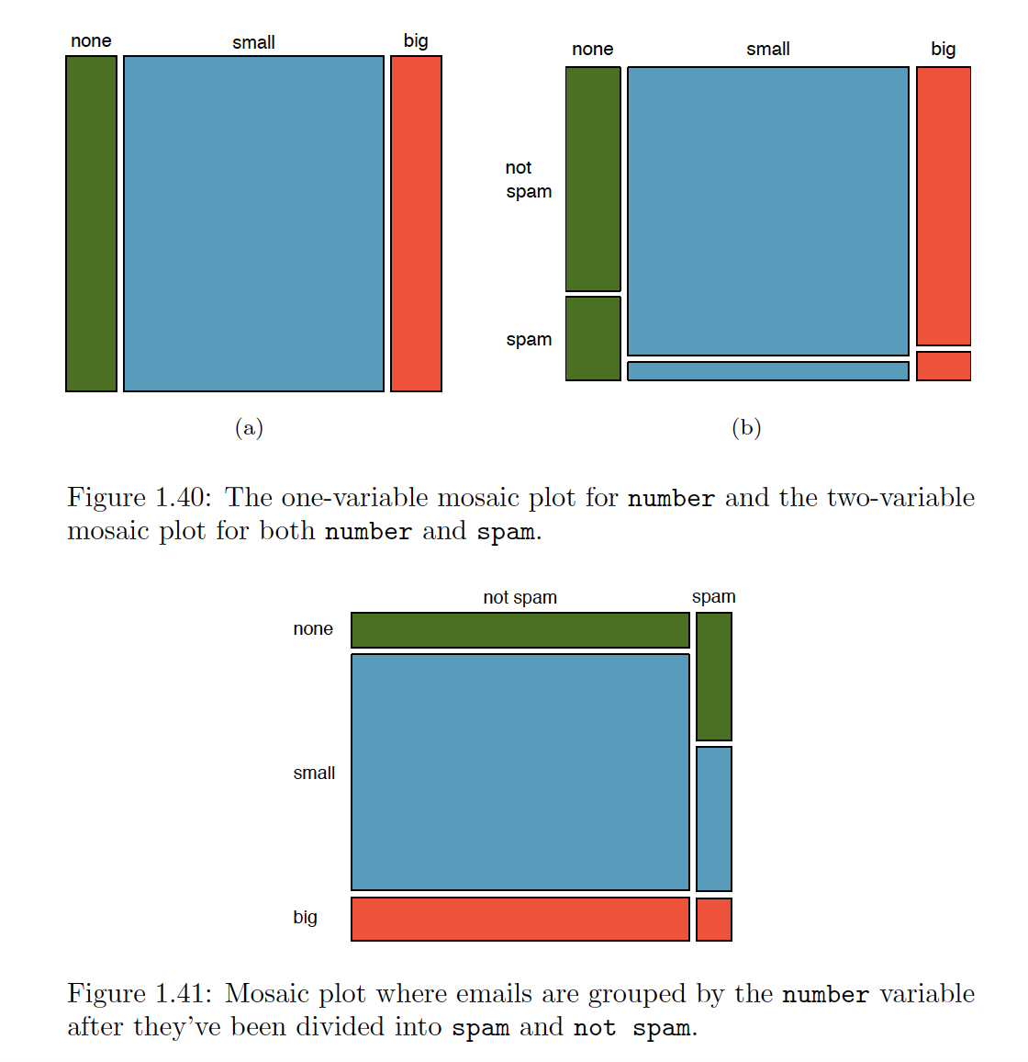
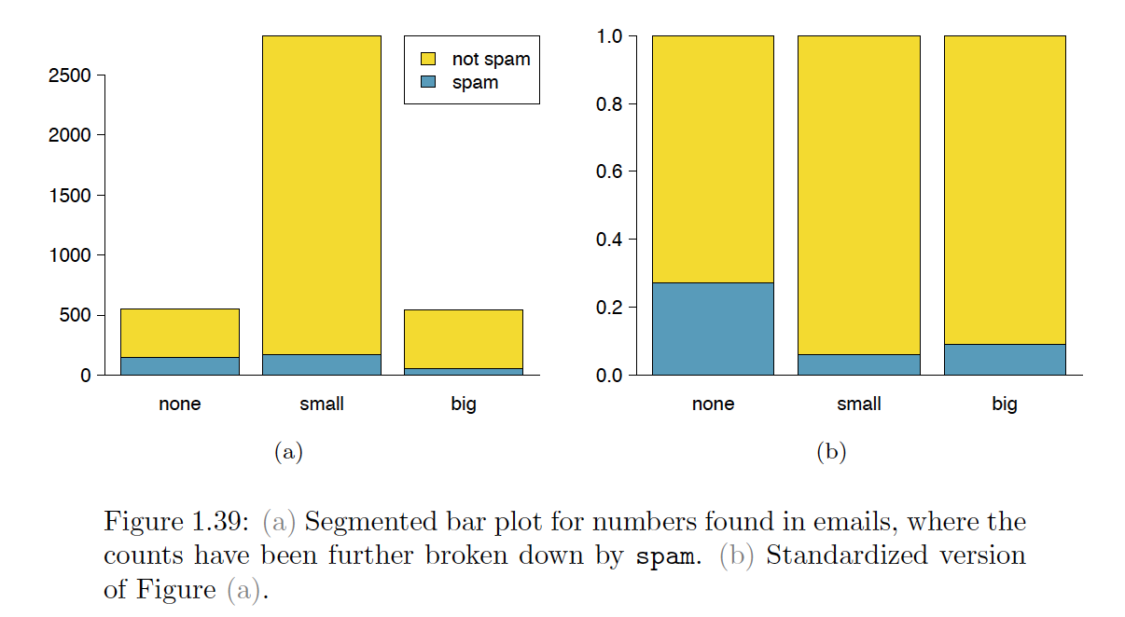
Segmented bar and mosaic plots

Slide 22
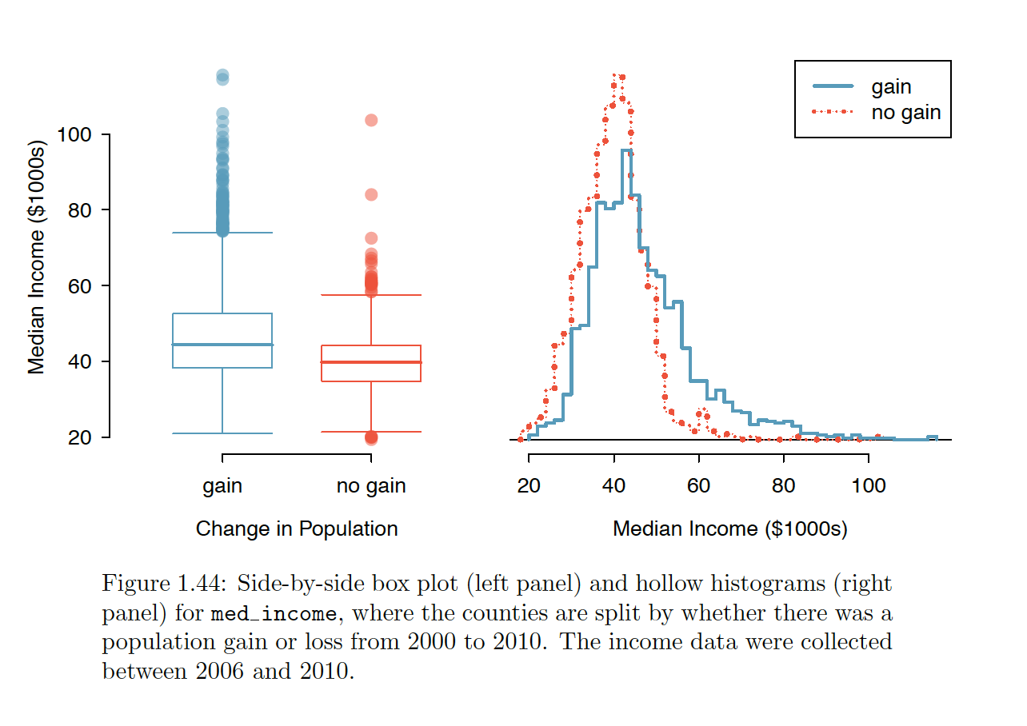
Comparing numerical data across groups
side-by-side box plot
hollow histograms

Slide 23
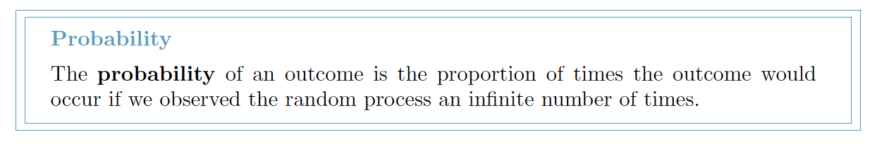
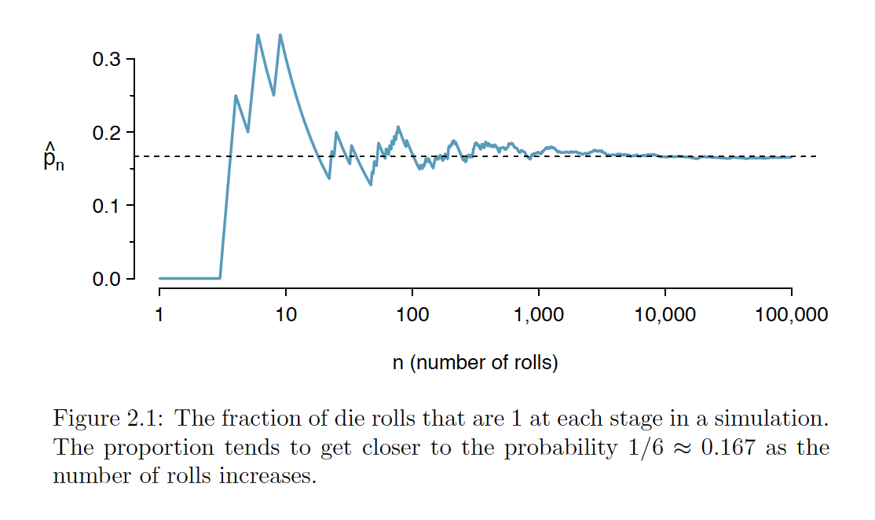
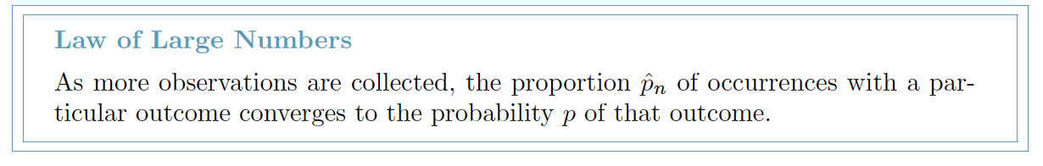
Probability - foundation for statistics

Slide 24
Disjoin sets
P( A or B) = P( A) + P( B) − P( A and B)
P( A1 or A2) = P( A1) + P( A2)

Slide 25
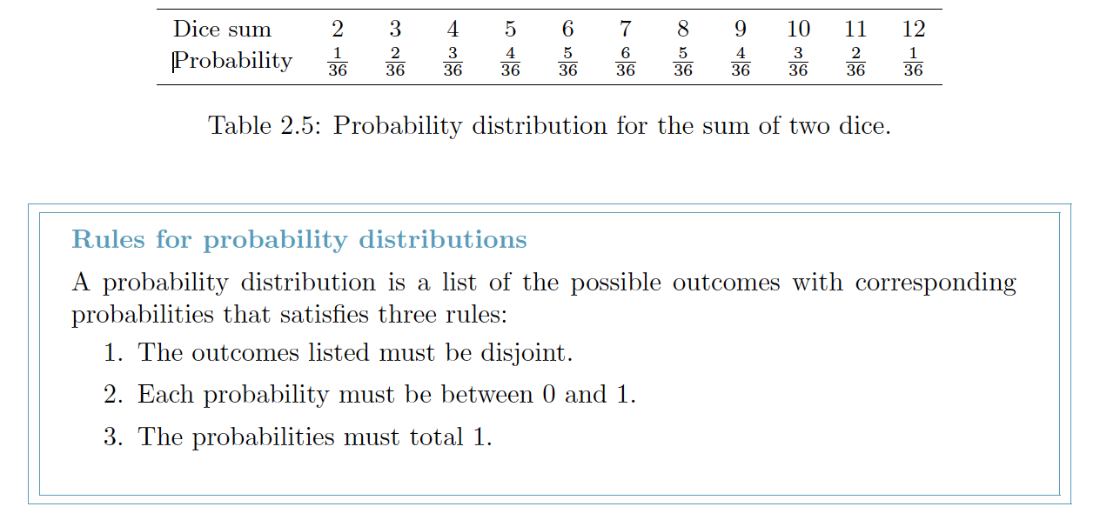
Probability distributions
A probability distribution is a table of all disjoint outcomes and their associated probabilities.

Slide 26
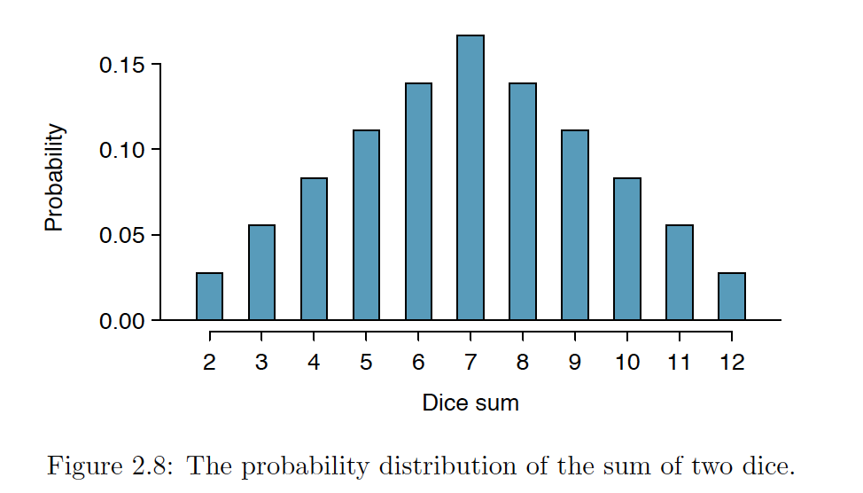

Slide 27
Complement of an Event
P( A or Ac) = 1
P(A or Ac) = P( A) + P( Ac)

Slide 28
Independent vs dependent
Two processes are independent if knowing the outcome of one provides no useful information about the outcome of the other.
flipping a coin and rolling a die are two independent processes
stock prices usually move up or down together, so they are not independent

Slide 29
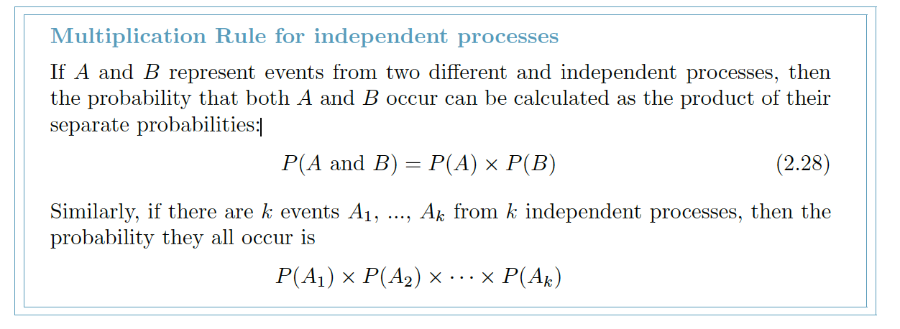
Multiplication Rule for independent processes

Slide 30
About 9% of people are left-handed Suppose 5 people are selected at random
Suppose the variables handedness and gender are independent, i.e. knowing someone’s gender provides no useful information about their handedness and vice-versa.
P(right-handed and female) = P(right-handed) X P(female)
= 0. 91 X 0. 50 = 0. 455

Slide 31
Conditional probability

Slide 32
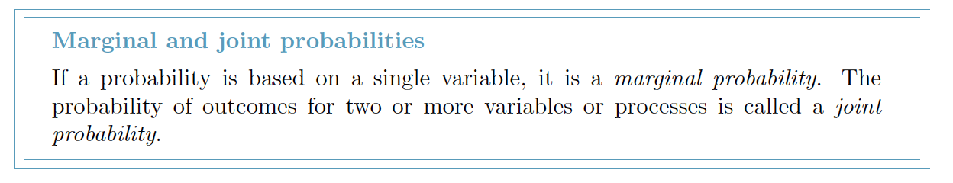
Marginal and joint probabilities -> Conditional Probabilities

Slide 33
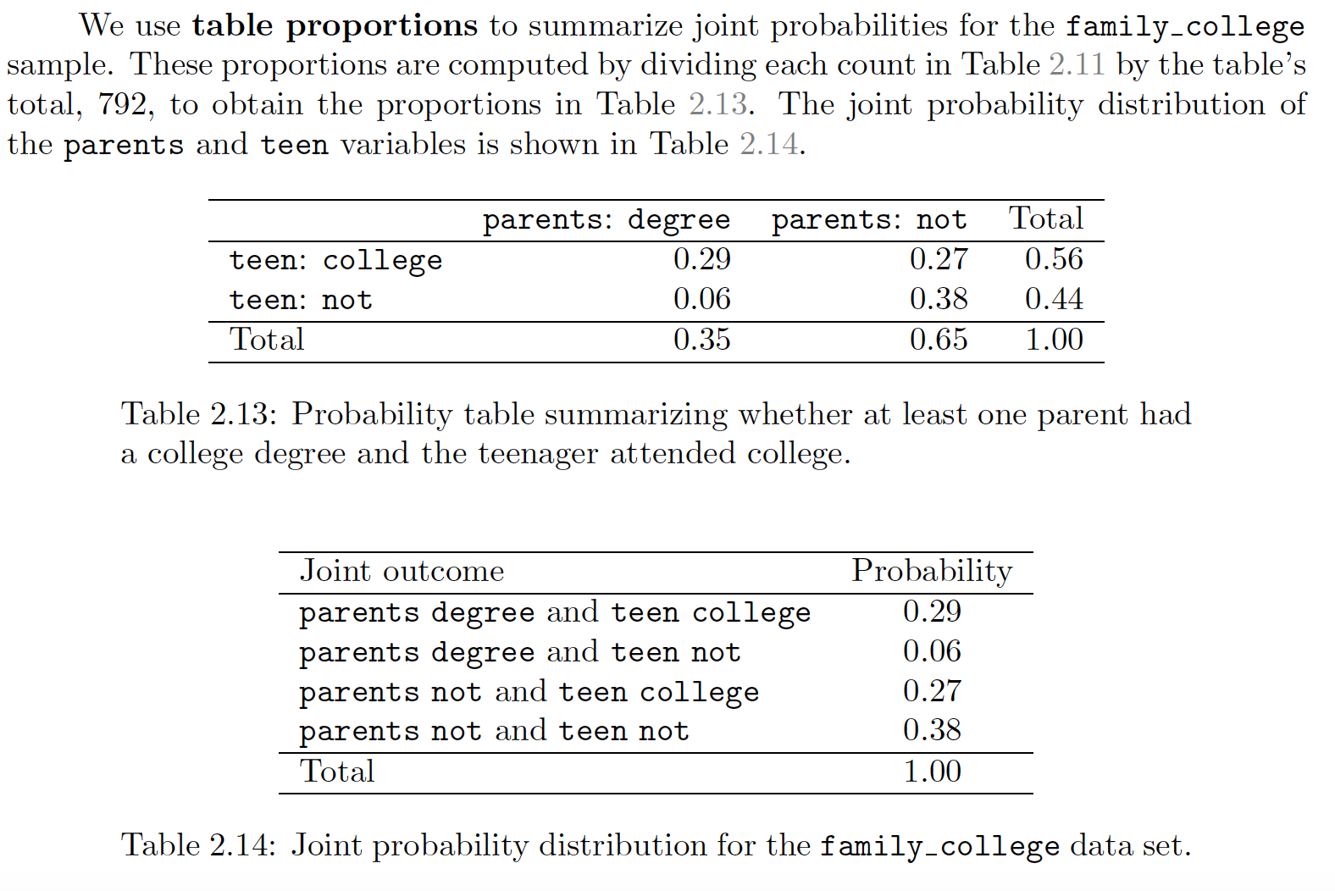
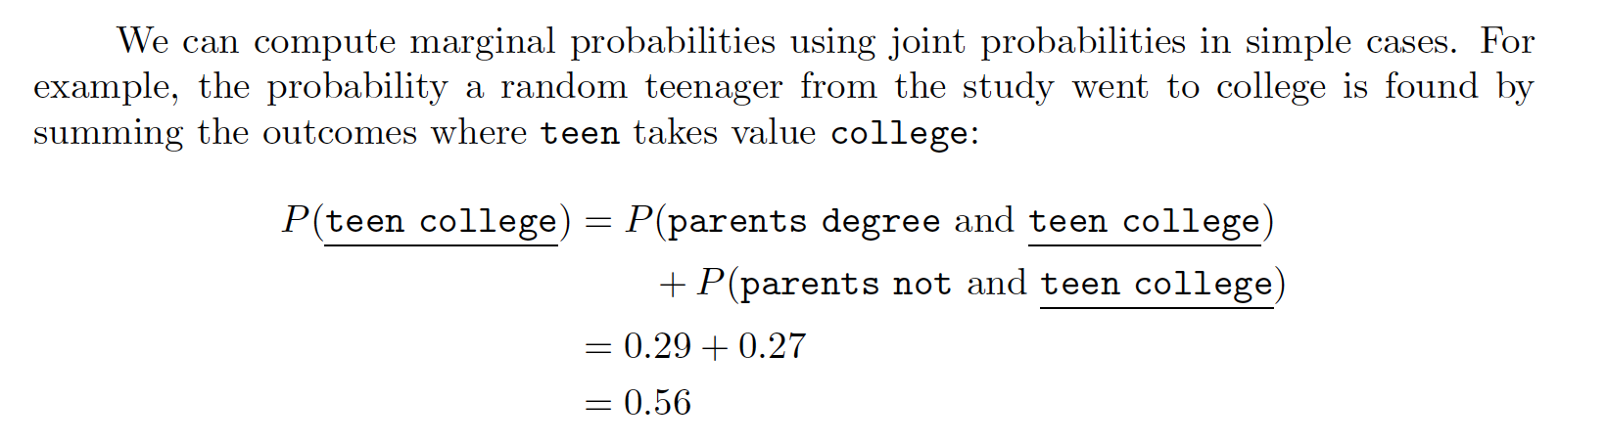

Slide 34
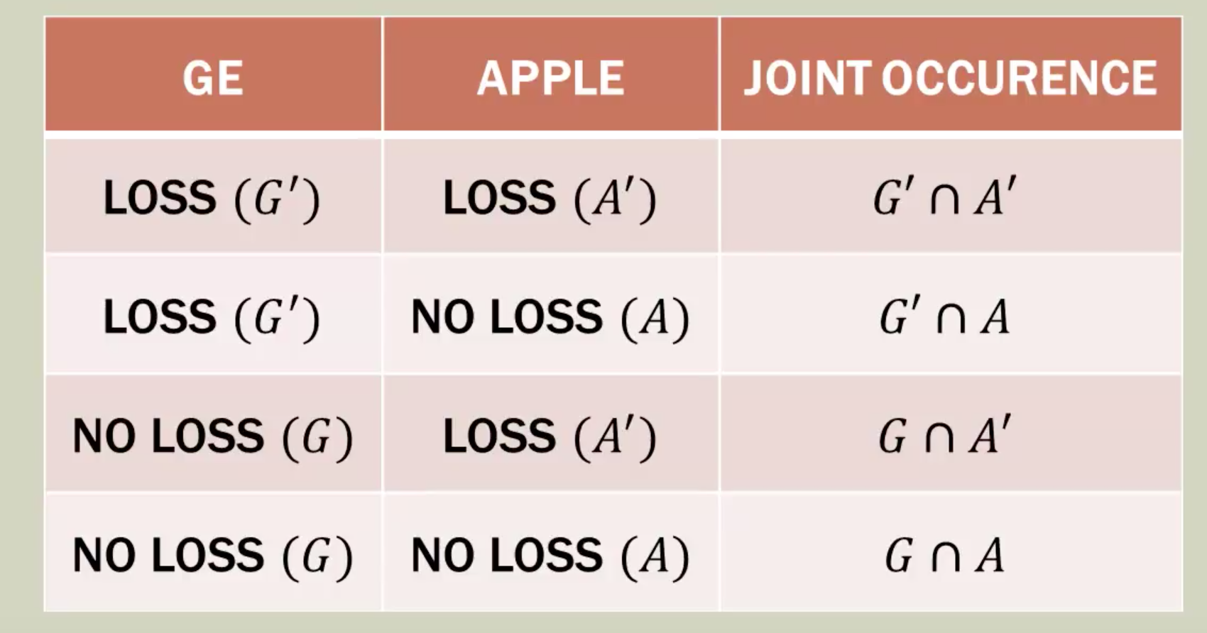

Slide 35
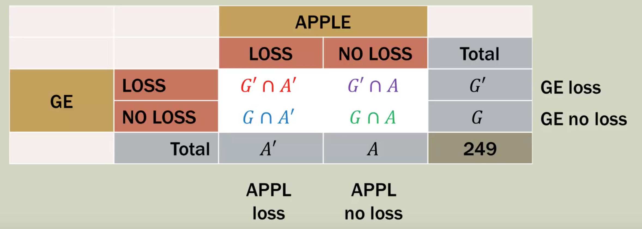

Slide 36
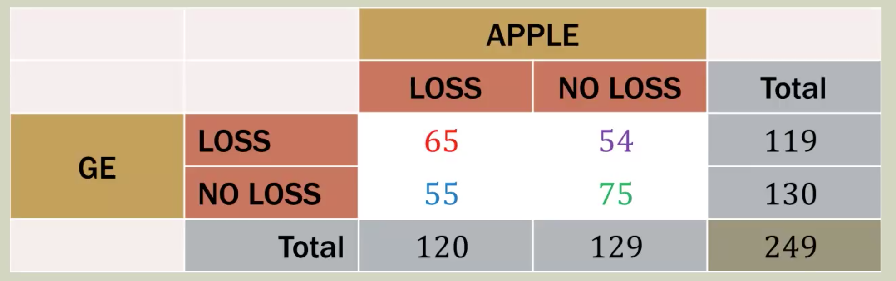
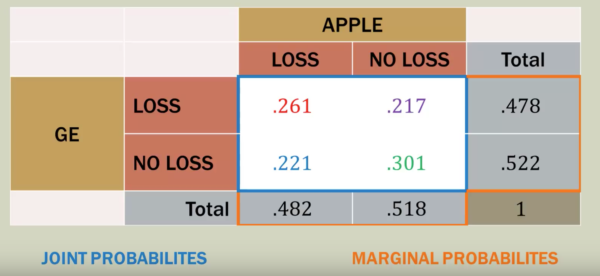
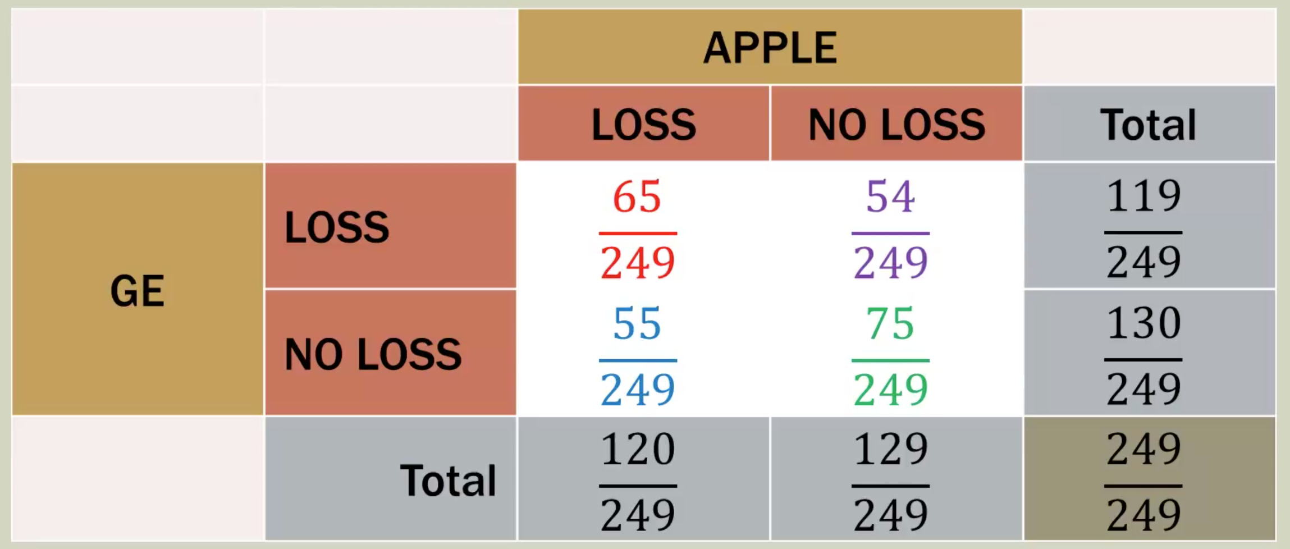

Slide 37
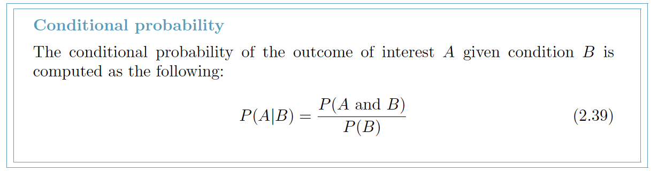
P(GE no loss | APPLE is no loss) = P(G n A) / P(A)

Slide 38
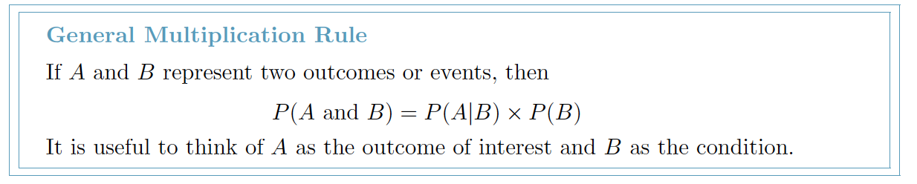
Multiplication Rule for dependent processes

Slide 39
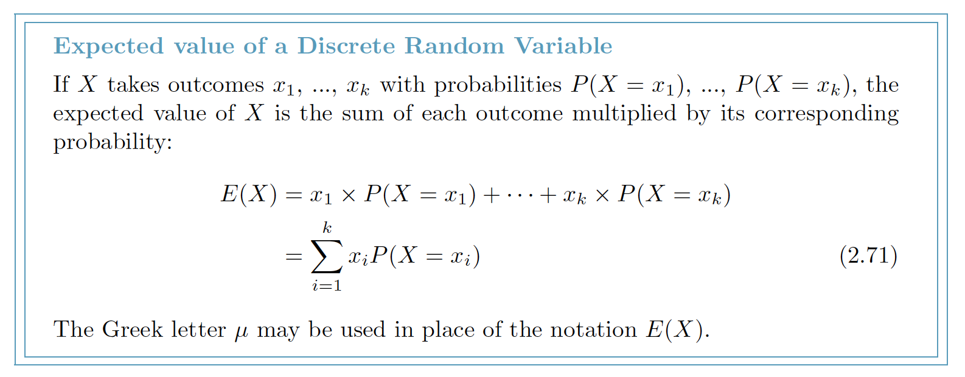
Random Variable X and Expected value E(X)
A random process or variable with a numerical outcome.

Slide 40
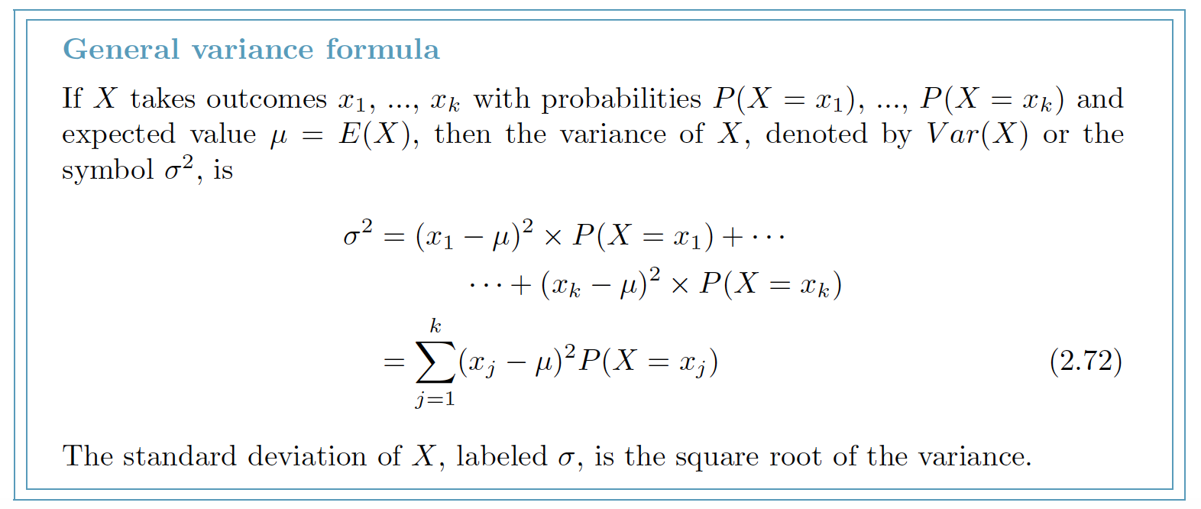
Variance Var(X)

Slide 41
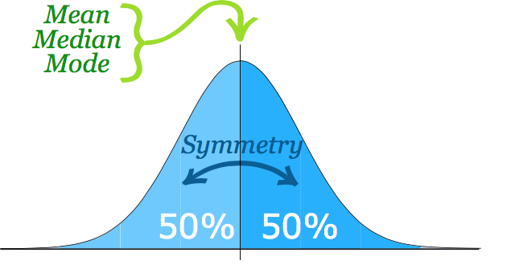
Distributions of random variables
The normal distribution model always describes a symmetric, unimodal, bell-shaped curve.

Slide 42
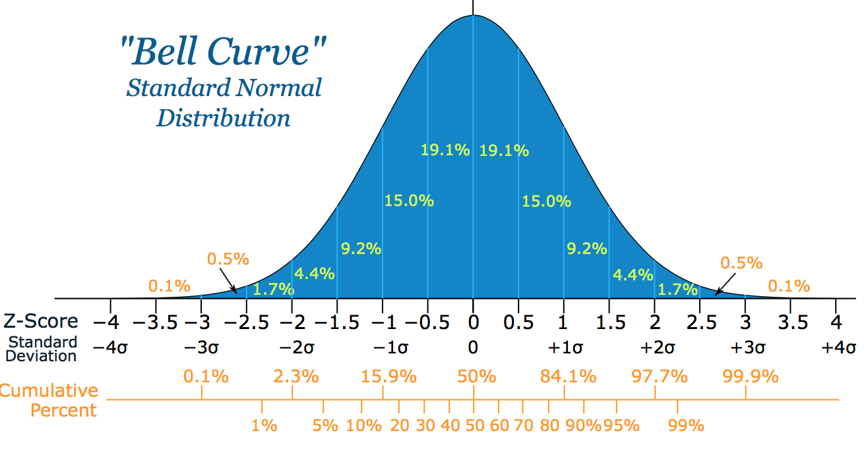
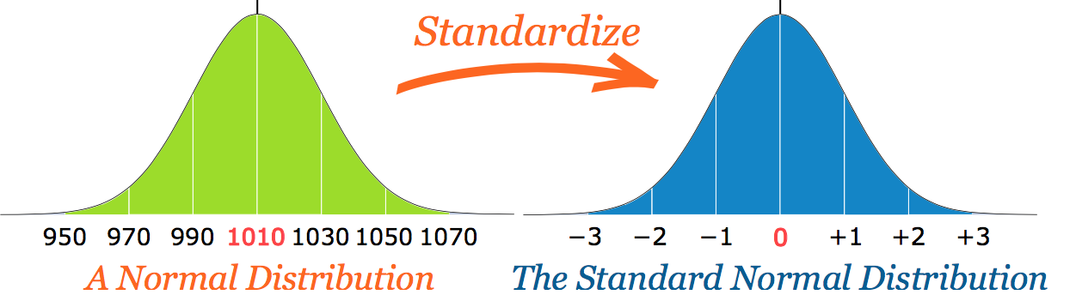

Slide 43
Quantiles and IQR (Q3 – Q1)

Slide 44
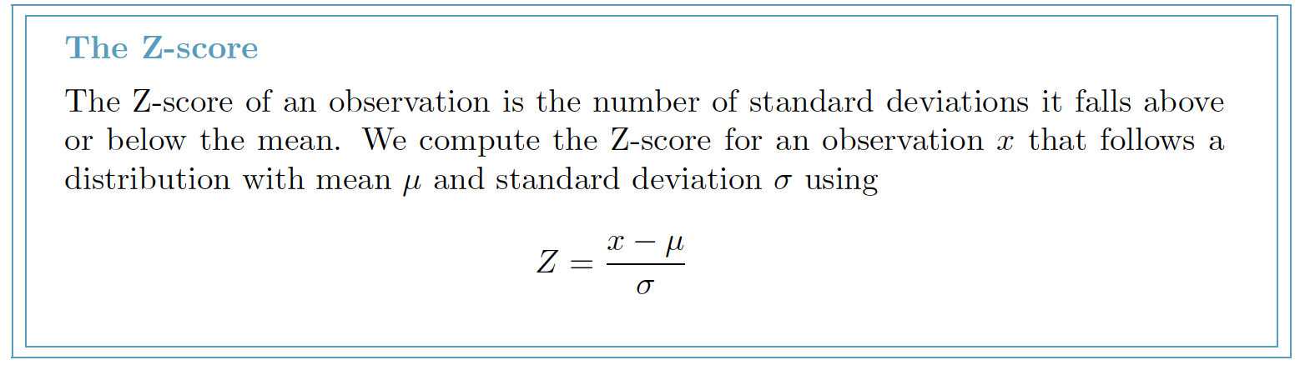
Standardizing with Z-scores

Slide 45
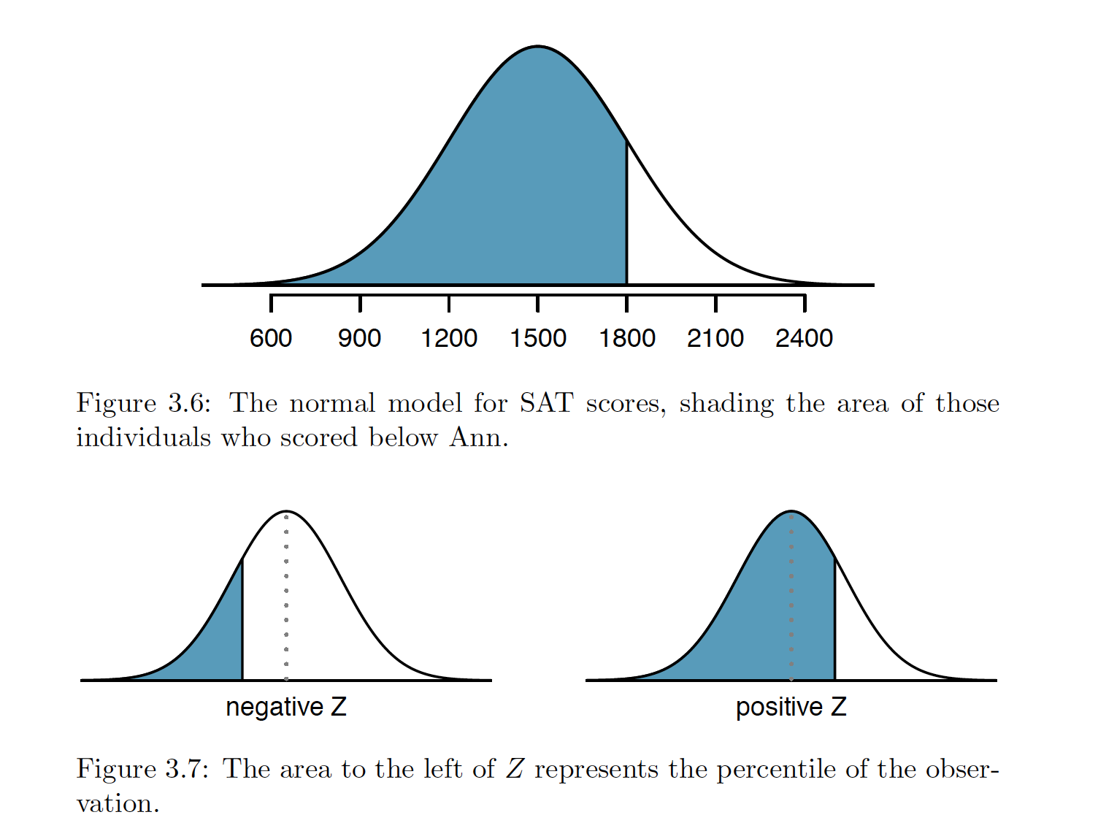
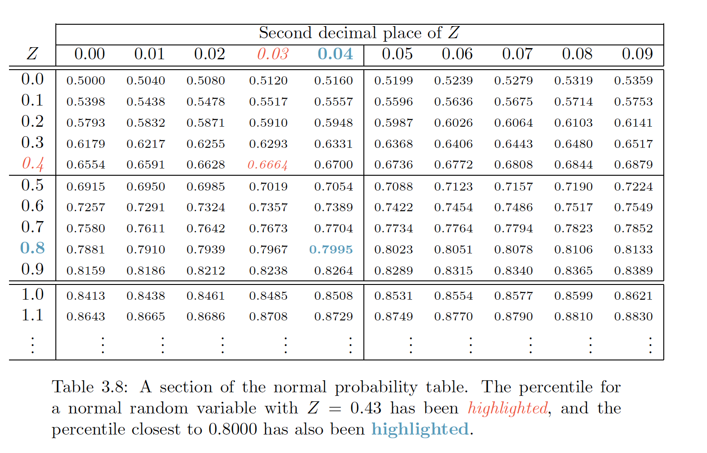
Normal probability table
Lists Z-scores and corresponding percentiles, can be used to identify a percentile based on the Z-score (and vice versa).

Slide 46
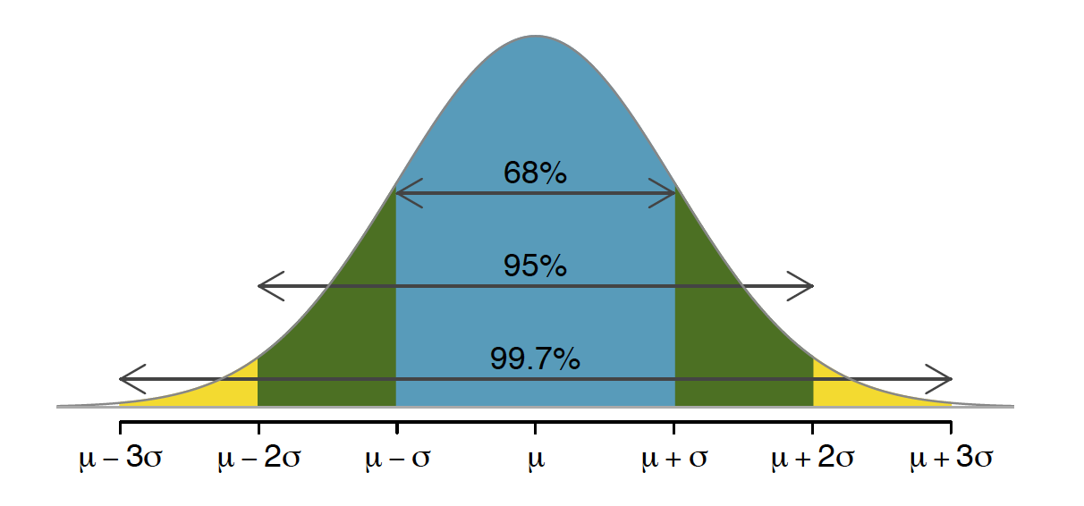
68-95-99.7 rule

Slide 47
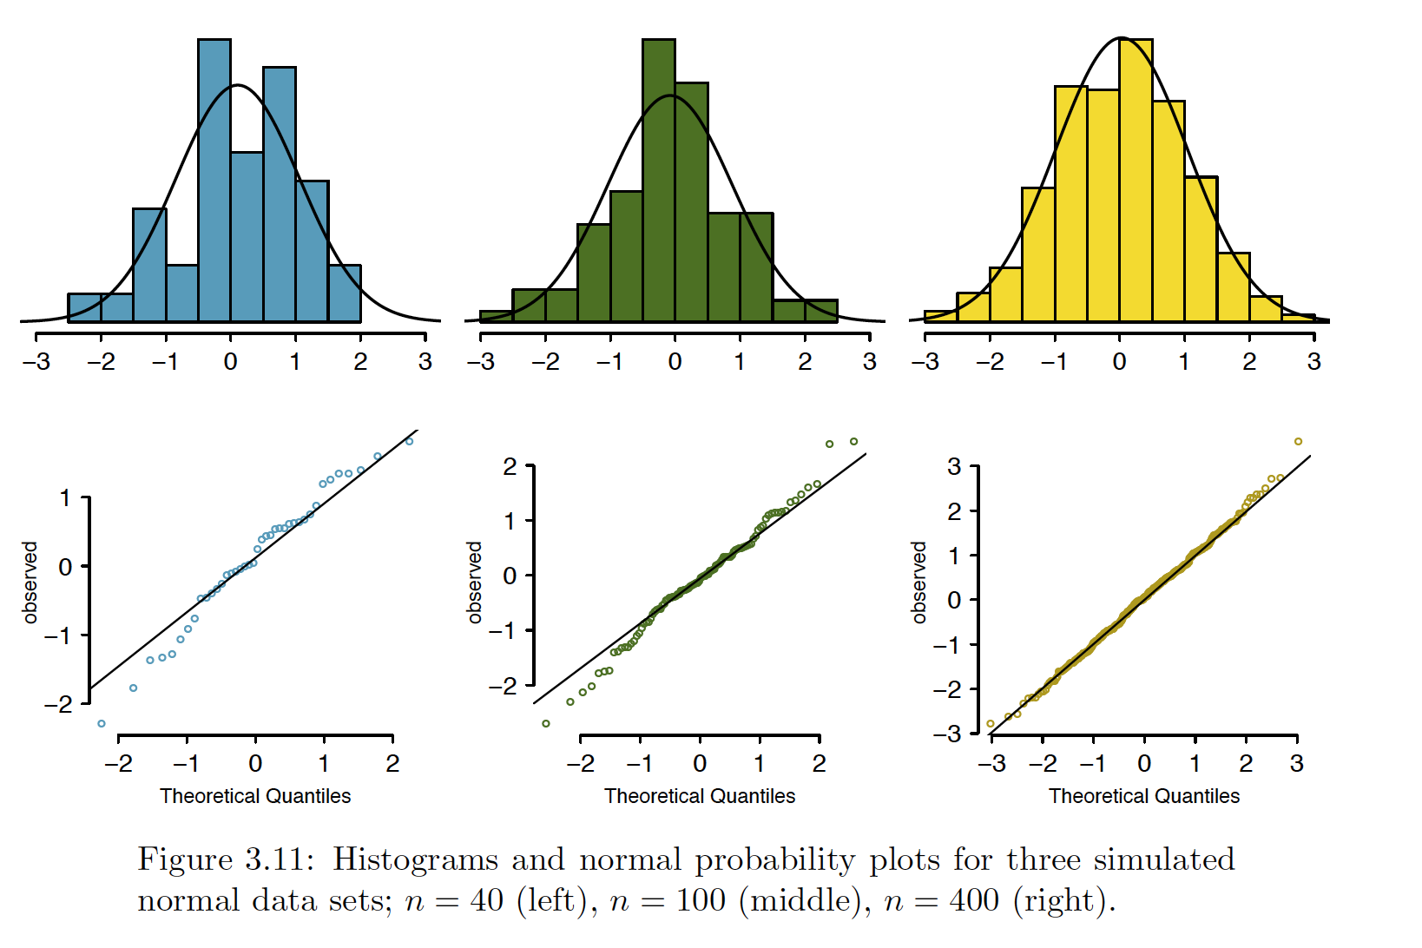
Evaluating the normal approximation
While using a normal model can be extremely convenient and helpful, it is important to remember normality is always an approximation. Testing the appropriateness of the normal assumption is a key step in many data analyses.

Slide 48
Is My Data Normal
Histograms
Stem and Leaf Plots
Box Plots (Box and Whisker Plots)
P-P Plots
Q-Q Plots

Slide 49
Geometric distribution
How long should we expect to flip a coin until it turns up heads?
How many times should we expect to roll a die until we get a 1?
These questions can be answered using the geometric distribution
We first formalize each trial – such as a single coin flip or die toss - using the Bernoulli distribution, and then we combine these with our tools from probability to construct the geometric distribution

Slide 51
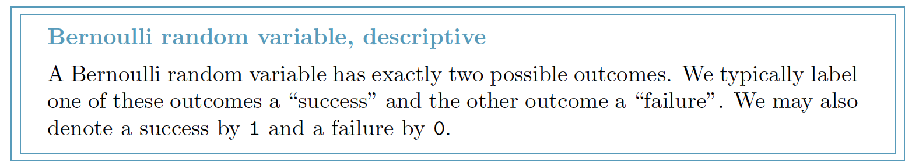
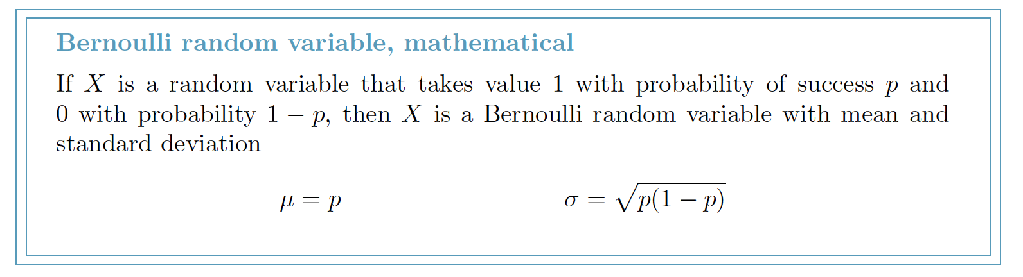
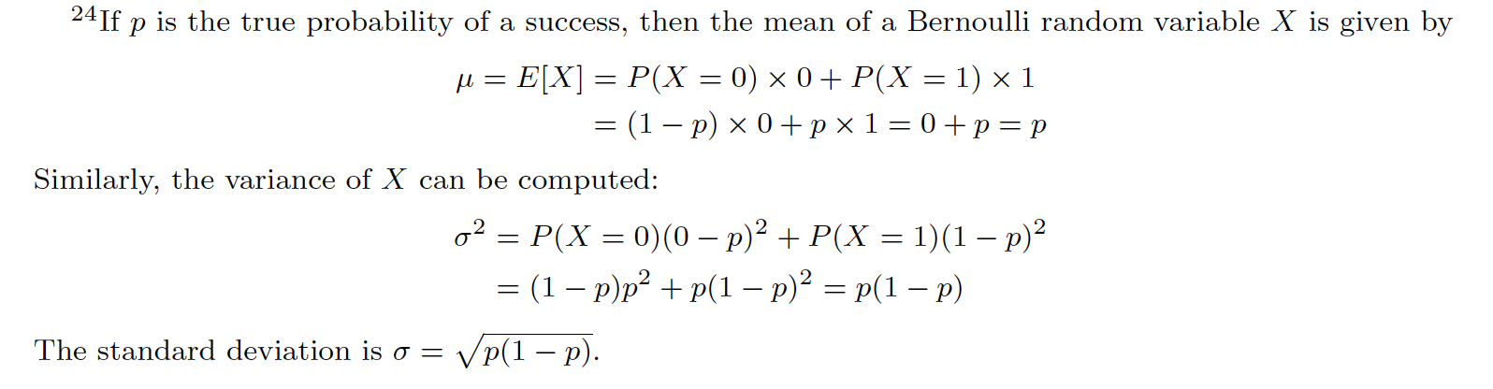
Bernoulli Distribution

Slide 52
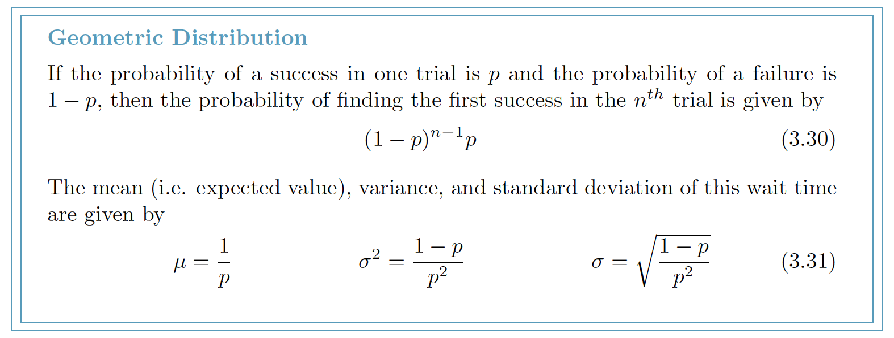
Geometric Distribution

Slide 53
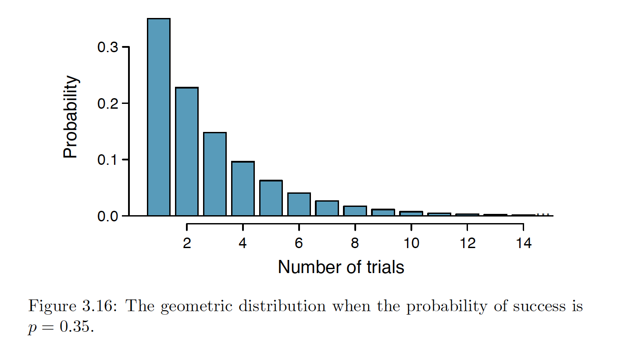

Slide 54
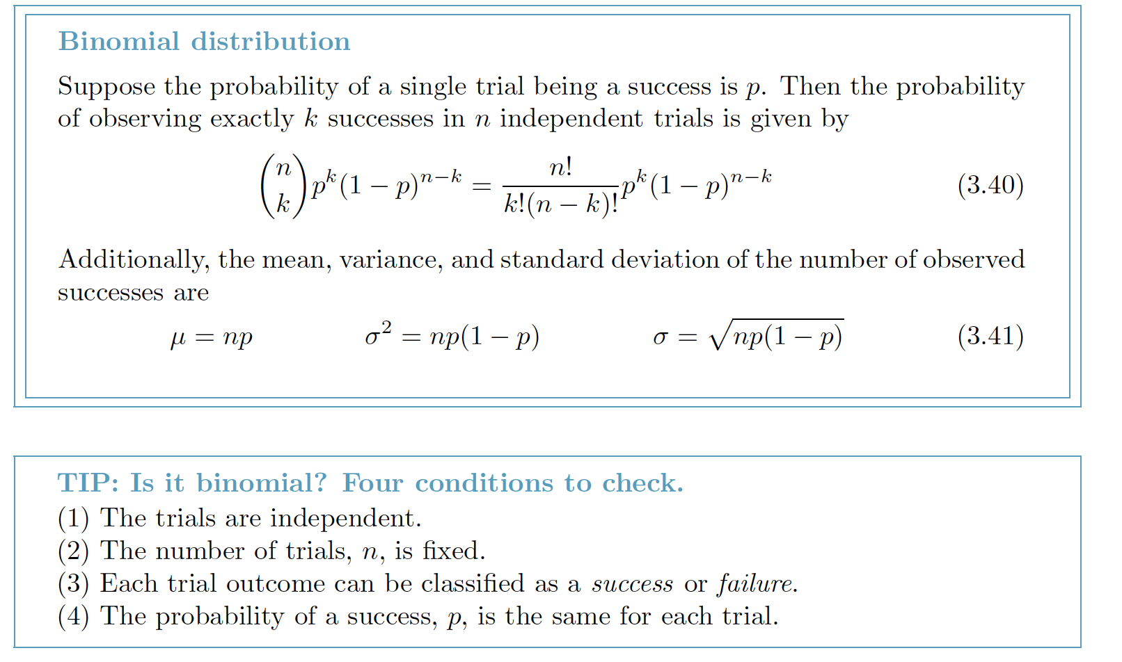
Binomial Distribution (two outcomes) special case of discrete probability distribution
Describes the probability of having exactly k successes in n independent Bernoulli trials with probability of a success p

Slide 55


Slide 56

More discrete distribution
Negative binomial distribution
The geometric distribution describes the probability of observing the first success on the nth trial. The negative binomial distribution is more general: it describes the probability of observing the kth success on the nth trial.

Slide 57


Slide 58


Slide 59
Poisson distribution
Useful for estimating the number of events in a large population over a unit of time.

Slide 60

Foundations for inference
Point estimate – sample mean

Slide 61


Sampling Distribution

Slide 62

Standard Error

Slide 63

Confidence Interval
point estimate ± 2 X SE

Slide 64

Central Limit Theorem

Slide 65

Extending the confidence interval

Slide 66

Conditions

Slide 67


Slide 68


We are XX% confident that the population parameter is between...

Slide 69
Hypothesis Testing
H0 – No Difference (Null hypothesis)
HA – There is difference (Alternative hypothesis)

Slide 70
Testing hypotheses using confidence intervals

Slide 71

Bottle

Slide 72

Hybrid Engine

Slide 73

Thinking about Hypothesis

Slide 74


Slide 75


Slide 76


Slide 77


Slide 79

We have the tools necessary to quantify how often we make such errors.

Slide 80

The FIRE Alarm Hypothesis

Slide 81

The Hypothesized vs True mean

Slide 82

Z-test or t-test

Slide 83

Alpha is type 1 error rate

Slide 84


Slide 85


Slide 86


Slide 87


Slide 88


Slide 89

T-distribution pattern

Slide 90


Slide 91


Slide 92


Paired Observations

Slide 93
Difference of two means (no paired data)
We apply these methods in three contexts
determining whether stem cells can improve heart function,
exploring the impact of pregnant women's smoking habits on birth weight of newborns,

Slide 94

ANOVA – ANalysis Of VAriance

Slide 95


Slide 96


Slide 97


Slide 98


Slide 99


Slide 100

F distribution

Slide 101


Slide 102


Slide 103


Slide 104


Slide 105


Slide 106


Slide 107
Conditions for ANOVA
the observations are independent within and across groups
the data within each group are nearly normal, and
the variability across the groups is about equal

Slide 108

Inference for categorical data

Slide 109

Chi-square test

Slide 110

Chi-square test

Slide 111
Covariance, Correlation and Covariance Matrix

Slide 112


Slide 113


Slide 114


Slide 115


Slide 116


Slide 117


Slide 118


Slide 119


Slide 120


Slide 121


Slide 122


Slide 123


Slide 124


Slide 125


Slide 126


Slide 127


Slide 128


Slide 129


Slide 130


Slide 131


Slide 132


Slide 133
Take away
Statistical tools rely on conditions. When the conditions are not met, these tools are unreliable and drawing conclusions from them is treacherous
Data are messy, and statistical tools are imperfect. But, when you understand the strengths and weaknesses of these tools, you can use them to learn about the real world.

Slide 134
http://www.bcfoltz.com/blog/stats-101/

